Slide 1
Cheating because games are boring
By Unortho

Slide 2
Software
Download the virtual image and open it with VirtualBox
What’s installed?
Popcap Heavy Weapon
Cheat Engine
Wininject
ReClass
Visual Studio + Whole Tomato

Slide 3
Software Context
Popcap Heavy Weapon
Game that we are going to cheat in
Cheat Engine
Memory scanner
Wininject
Tool to inject code into another application’s memory space
ReClass
Tool to recreate classes (thus the name ReClass, maybe?) that the game uses

Slide 4
Windows concepts
Why do we need these tools?
Applications are executed in their own separated memory locations
Application A cannot view/change the memory that application B is using
Using Windows APIs, processes can read memory that belongs to another process
ReadProcessMemory
WriteProcessMemory
etc

Slide 5
Game design concepts
Game designers love their object-orientated code
We will take advantage of this using ReClass
Static address vs dynamic address
Static address: an address in memory that never changes (not using ‘new’), even when the game is restarted
Example: local player class
Only one local player, therefore
CPlayer LocalPlayer();
Dynamic address: an address that changes every time the game is restarted or deleted
Example: bullet class
There are multiple bullets in the game, therefore
CBullet Bullet = new Bullet[10]…..

Slide 6
Cheat Engine
Memory scanning is long and tedious
Might find dynamic addresses, might find static addresses
General process of memory scanning
Example: finding health
Scan unknown values – takes an “image” of the process’s current state
Go into said game and receive damage
Scan “decreased values”
Repeat till a few addresses or left
Test each by modifying the values until you get a hit

Slide 7
Demo/Workshop
First goal: find addresses that are points of interest
Lives
Shield
Attachments
Etc
Open up Cheat Engine
Open Heavy Weapon

Slide 8
Programming the cheat
Preexisting knowledge of
C/C++
Pass by references vs Pass by value (pointers vs statically allocated memory)
Required Windows API, Google is your friend
OpenProcess
ReadProcessMemory
WriteProcessMemory

Slide 9
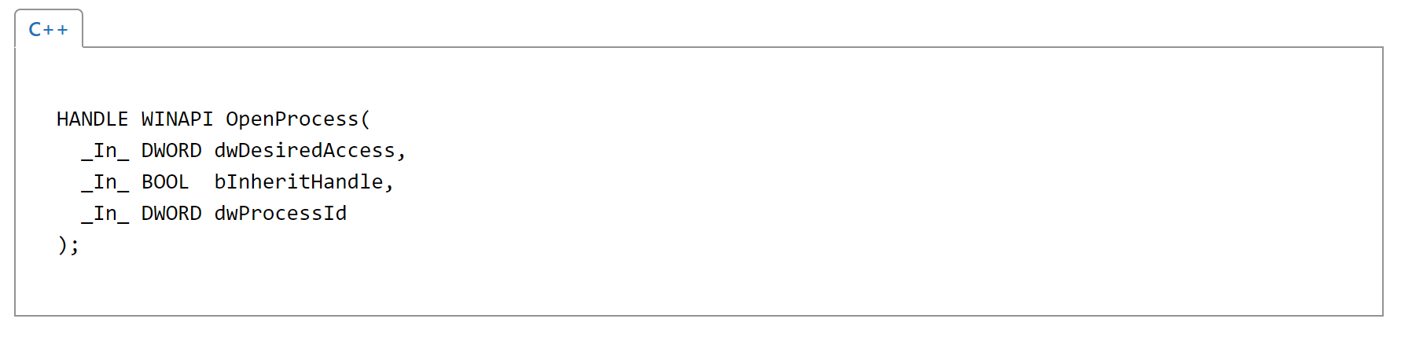
OpenProcess (http://bfy.tw/BmnK)

Slide 10
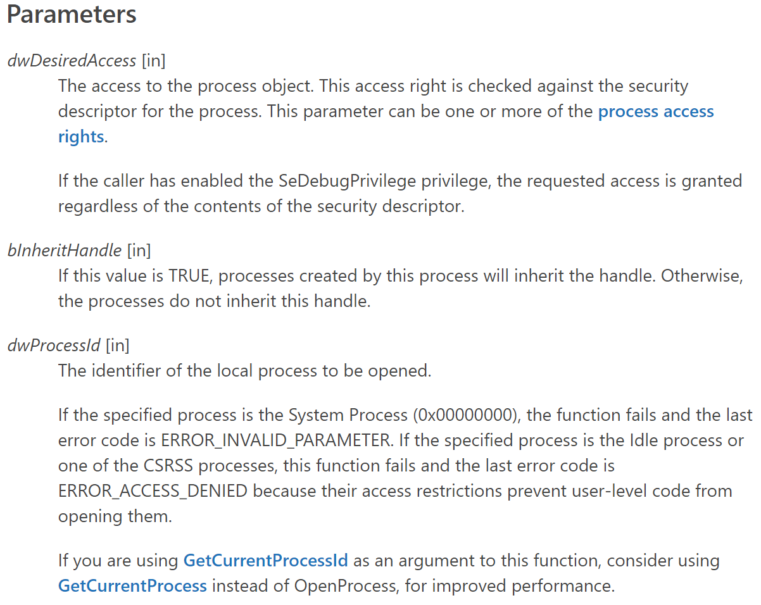
OpenProcess

Slide 11
Demo/Workshop
Second goal: Implement the new found knowledge
Open Visual Studio

